Slide 1
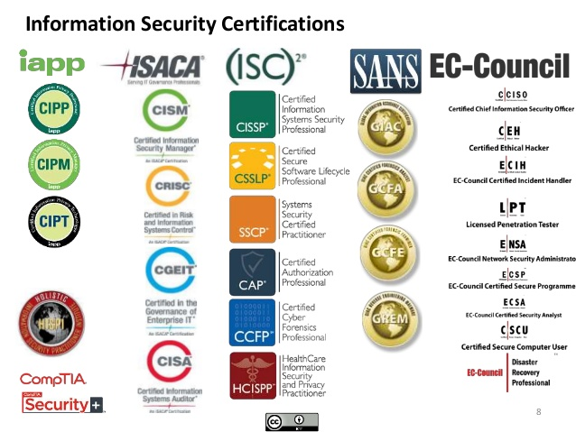

Slide 2

NEEDED SILLS

Slide 3
NEEDED SKILLS
Networking
CCNA
Comptia Network+
Certification is NOT required
CBT Nuggets training

Slide 4
NEEDED SKILLS
General Cybersecurity Knowledge
Malware and attacks
Preventive measures, antivirus, firewalls, IDS & IPS etc
Hackers and hacking methodology and software
Hacking software - Wireshark, Nmap, Cain & Abel
Social media, online identity, privacy, anonymity
Check out my 2 beginners courses

Slide 5
NEEDED SKILLS
Programming?
Helps but NOT required
Depends on your specialization
Python language

Slide 6
NEEDED SKILLS
Soft skills
Presentation
Analytical mind
Ability to work with a team
Networking
etc

